Slide 1
Joining a Lync Meeting via WEB or Lync Attendee

Slide 2
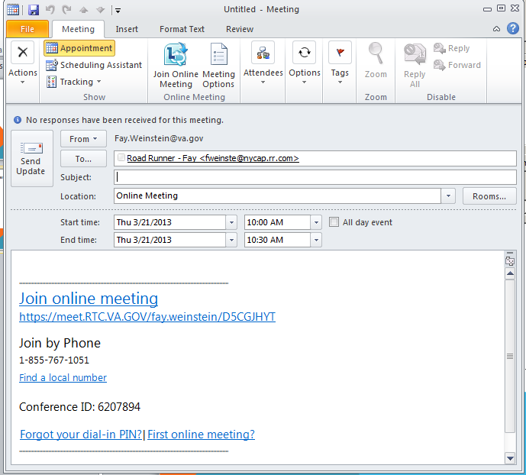
Invitation
Click on Join online meeting

Slide 3
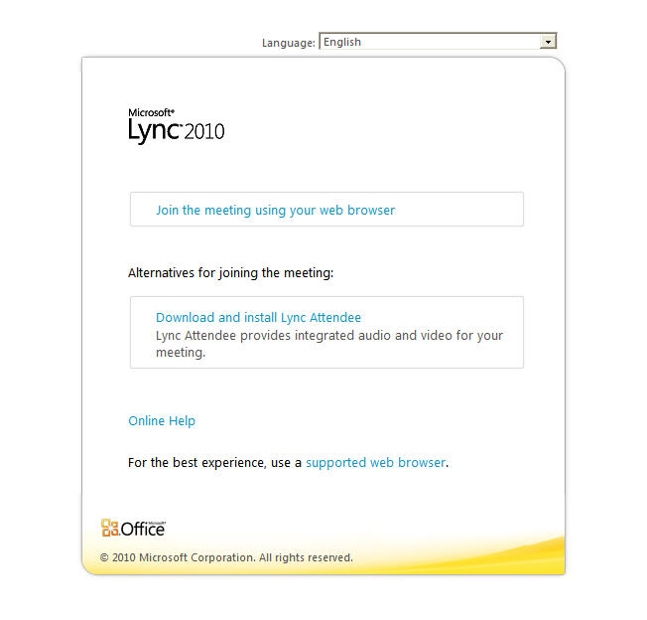
Lync Meetings
If you do not have the Lync Attendee Client select “Join the meeting using your web browser”
VA Staff should have the Lync Attendee Client already installed and the window to the right should not pop-up.

Slide 4
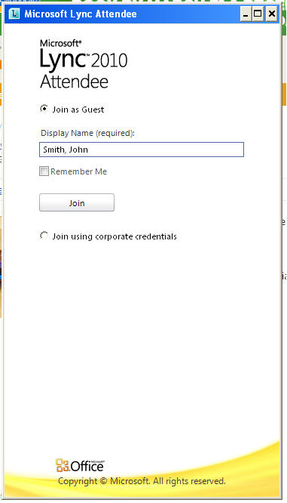
Lync Meetings
If the Lync Attendee client is installed this is the window that should pop-up.
If you are external to the VA, click on Join as Guest
Type in a real full name.
If you are internal to the VA click “Join using corporate credentials”

Slide 5
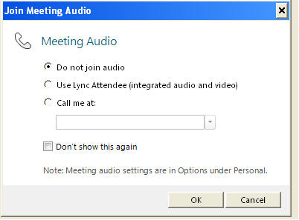
Lync Meetings
If you are external or on a computer without speakers and microphone choose “Do not join audio”
If you are internal and have the Lync Attendee client and have speakers and microphone on your computer (or a headset with microphone ) then try choosing “Use Lync Attendee integrated….”
If this doesn’t work you have drivers that are not compatible with Lync and need to select the first radial dial.
Do NOT check the “don’t show this again”

